Slide 1

Self-starting as a 3D graphics programmer
Nick Driscoll

Slide 2
Who am I?
Self-taught programmer since HS, DevOps engineer
Been studying realtime 3D graphics programming since my graduation from OSU’s computer science program in 2019
Developing a physically-based renderer in Rust using Vulkan
Wanted to give new programmers interested in low-level graphics programming a foundation for learning

Slide 3
Agenda
Define the technical problem of video game graphics
Intro to 3D graphics pipeline – high level algorithm
Detailed account of the three major pipeline stages
End with discussion of APIs, debugging tools, and how to learn

Slide 4
Note
Disclaimer: No statements made here will be authoritative or 100% accurate in all cases
These slides will be available online after the talk
No need to squint to read code samples
All code samples are in GLSL

Slide 5
What are we not talking about here?
Won’t be discussed:
Artist-facing responsibilities
Creating models/animations/textures
Super-modern stuff, raytracing, mesh shaders, etc.

Slide 6
The task at hand
Video games display graphics on a screen
2D grid of square pixels (1920x1080 for 1080p)
Each pixel can be exactly one color at a time (represented as an RGB triplet)
The current “screen“ being rendered to is called the "rendertarget" or "framebuffer"
The game must draw/render images by computing each pixel’s color value
The individual images produced by the game are typically referred to as frames

Slide 7
3D to 2D?​
We want to be able to render a frame given a description of a particular 3D scene
3D Objects
Camera position and orientation
Light sources
How do we represent 3D objects in a way that a computer can understand?
3D object surfaces are made up of a bunch of triangles
One list (array) of 3D vertex positions (Vertex buffer)
One list (array) of triangle connectivity info (Index buffer)
Together these buffers describe a list of triangles
We want an algorithm that can take triangle lists as input and produce colored on-screen pixels as output...

Slide 8
Enter: 3D graphics pipeline
The main algorithm that allows programs to render 3D objects is the 3D graphics pipeline
The pipeline accepts a list of triangles as input, and as output it writes colored pixels to a specified rendertarget
One run through of this pipeline is called a "draw call"
Much of the pipeline’s behavior is defined through configurable state, meaning some input data is defined in advance of the draw call

Slide 9
Enter: 3D graphics pipeline
Three major steps comprise the pipeline:
1 - Vertex processing
Vertex positions are transformed from 3D world space into 2D screen space, along with any other per-vertex work
2 - Rasterization
For each screen-space triangle, pixel coverage is determined
Vertex attributes (I.E. position) are interpolated
3 - Pixel processing
Pixels covered by the triangle are assigned a color
When a pixel has completed processing, it is written out to the rendertarget

Slide 10
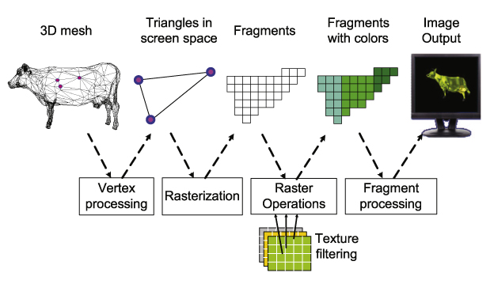
3D graphics pipeline illustration
Simplified 3D graphics pipeline

Slide 11
3D graphics pipeline: Conclusion
The previous steps are all there is to getting 3D triangles drawn on a 2D screen
We will now revisit each step in more detail

Slide 12
3D graphics pipeline: The Second Pass
Three major steps comprise the pipeline:
1 - Vertex processing
Vertex positions are transformed from 3D world space into 2D screen space
2 - Rasterization
For each screen-space triangle, pixel coverage is determined
Vertex attributes (I.E. position) are interpolated
3 - Pixel processing
Pixels covered by the triangle are assigned a color
When a pixel has completed processing, it is written out to the rendertarget

Slide 13
Vertex processing
For each vertex in a particular draw call, a GPU program called the vertex shader will be executed
The primary responsibility of the vertex shader is to take a vertex represented in 3D world-space and output its 2D screen-space position
A “space” is just a coordinate system, like from math
The vertex shader is also responsible for any other per-vertex processing that you would like the GPU to do in a given draw call

Slide 14
Vertex processing cont.
“How exactly is a 3D world-space position transformed into a 2D screen-space position?“
I didn’t want this to become a math talk, but...
Oversimplified concepts from linear algebra:
Vector: a point in a space
Matrix: represents a transformation from one space to another
So, if you have a vector in space A, and you have a matrix that represents a transformation from space A to space B, then you can multiply the matrix with the vector to get the same vector in space B

Slide 15
Vertex processing cont.
Each object in the world will have at least one matrix that describes its position in the world
There will also be a matrix that represents the camera’s position in the world, as well as a matrix that describes how to project what the camera sees onto the screen
Position
Rotation
Field-of-view

Slide 16
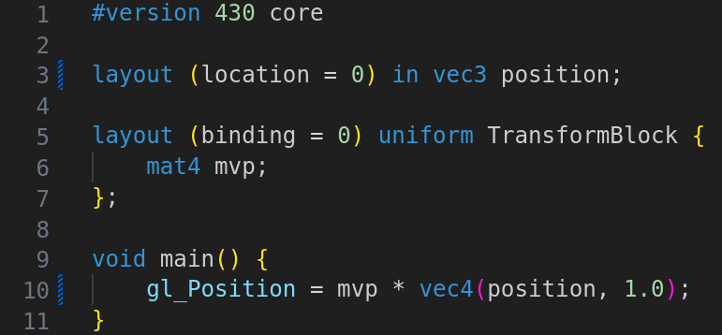
Vertex processing illustration
In the following code sample, the vertex shader multiplies an input vertex by the matrix that represents the transform from 3D space to screen space

Slide 17
3D graphics pipeline: The Second Pass
Three major steps comprise the pipeline:
1 - Vertex processing
Vertex positions are transformed from 3D world space into 2D screen space
2 - Rasterization
For each screen-space triangle, pixel coverage is determined
Vertex attributes (I.E. position) are interpolated
3 - Pixel processing
Pixels covered by the triangle are assigned a color
When a pixel has completed processing, it is written out to the rendertarget

Slide 18
Rasterization
After the transformation into screen space, the pixels that are covered by each triangle need to be determined via a process called rasterization
Lucky for us, the hardware does all of the work!
Instead of being fully programmable like the vertex and pixel stages, the rasterization step only has configurable attributes:
Viewport/Scissor rectangles
Polygon mode (I.E. wireframe or solid)
Sampling rate (MSAA)
Lots more

Slide 19
Rasterization: vertex attributes
One of the most important concepts regarding the rasterizer is the concept of vertex attribute interpolation
Each vertex will have associated with it some pieces of data, called vertex attributes
3D position at minimum, but also any other desired data
The rasterizer takes special care to make sure that interpolated attributes are "perspective correct"

Slide 20
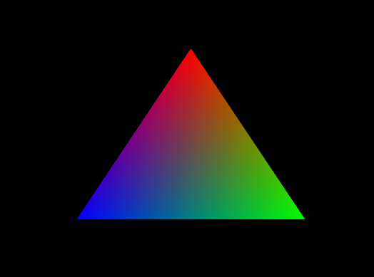
Rasterization cont.
Rasterized pixels will receive a value per vertex attribute that will be the linear interpolation of the three
In this example, each vertex has been assigned a solid color
You can see how each pixel has been assigned a color in proportion to how close it is to each vertex

Slide 21
3D graphics pipeline: The Second Pass
Three major steps comprise the pipeline:
1 - Vertex processing
Vertex positions are transformed from 3D world space into 2D screen space
2 - Rasterization
For each screen-space triangle, pixel coverage is determined
Vertex attributes (I.E. position) are interpolated
3 - Pixel processing
Pixels covered by the triangle are assigned a color
When a pixel has completed processing, it is written out to the rendertarget

Slide 22
Pixel processing
Each rasterized triangle will cover some number of pixels
For each of these pixels, the pixel shader’s code will be executed
The output of this shader will be the final color value that the pixel will be on screen
This is where all logic related to lighting, textures, shadows, etc. happen

Slide 23
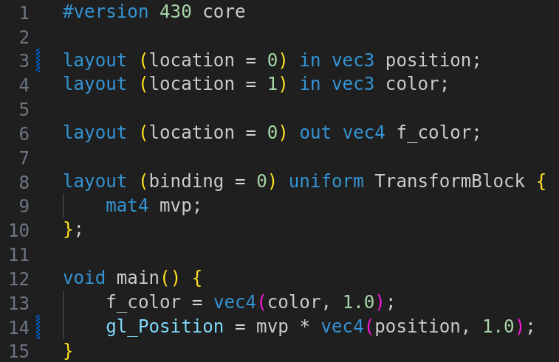
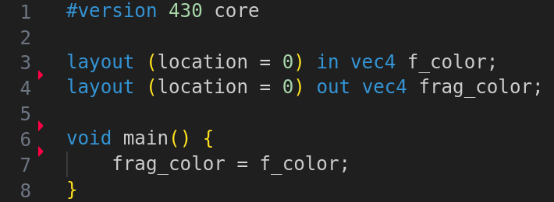
Pixel shader example
Pixel shader
Vertex shader

Slide 24
Actually building something
We just finished covering the main theory behind 3D graphics programming
How do we actually start writing code?
GPU APIs
Debugging tools
Resources for getting started
Presentations, Papers, and the wider community

Slide 25
Graphics/GPU APIs
API – Application Programming Interface
Composed of data structures and function definitions
APIs for programming graphics can be sorted into two major categories
Graphics APIs – Older, designed specifically for graphics
Direct3D 11 (and lower versions)
OpenGL
GPU APIs – Newer, designed for general control of the GPU
Direct3D 12
Vulkan
Metal

Slide 26
Graphics debugging tools
RenderDoc - Free MIT licensed graphics debugger that allows single-frame capture and detailed introspection of any application using most GPU APIs
Allows you to open any 3D graphics application and look at the API function calls it made during a particular frame
Invaluable for starting out

Slide 27
Vendor tools
GPU vendors have official tools that are more fully featured but are less intuitive to use
NVIDIA Nsight
AMD Radeon GPU Profiler
Intel Graphics Frame Profiler

Slide 28
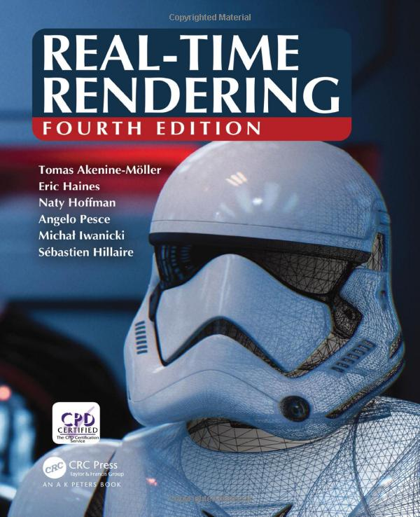
Resources for getting started
https://learnopengl.com
Easy to digest, but can be inaccurate when going beyond the basics
Real-Time Rendering Fourth Edition (2018)
Broad survey of most realtime rendering techniques
Lacks depth, but provides plenty of terms to go look up later

Slide 29
Papers? Please.
When you’re more intermediate and are looking to learn specific graphics techniques, one great place to look are the presentations and papers of graphics professionals
SIGGRAPH
ARXIV
Graphics Programming Weekly by Jendrik Ilner

Slide 30

Discord
Graphics Programming discord
https://discord.com/invite/udmRMSc
Can find API specific discords from there as well
Reading the occasional conversation can teach you a ton

Slide 31
Miscellaneous
Code libraries
SDL2 for windowing
GLM for linear algebra
Dear ImGUI for simple in-app UI

Slide 32


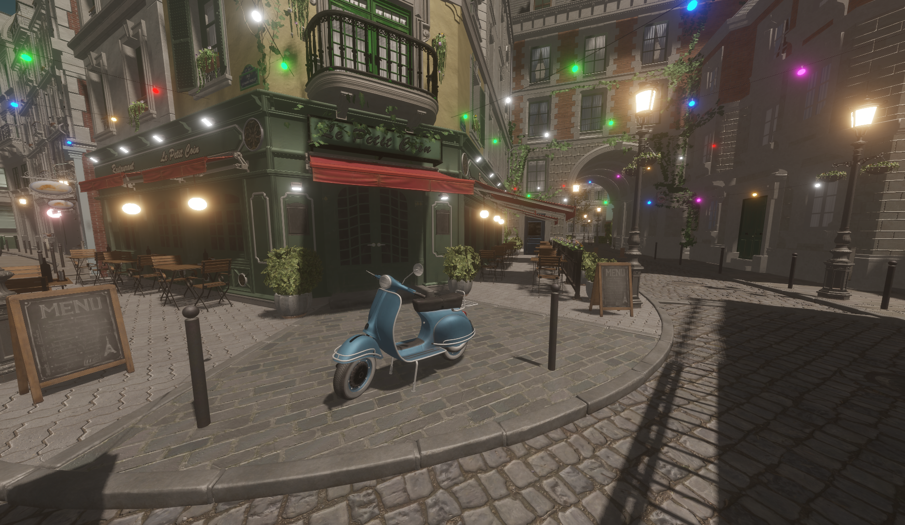


Q&A
Follow me on Mastodon:
My website:
Link to slides:

